Slide 1
Guided Minimum Spanning Tree for Vessel Segmentation in Fundus Image
Aashis Khanal
Georgia State University
CSC 8980 Graph Data Mining
Fall 2017

Slide 2
Contents
Introduction
Motivation
Methodology
Experiments

Slide 3
Introduction
Image segmentation is a classic problem in the field of image processing.
It has been widely used in medical diagnosis to study and analyze minute details for better diagnosis and treatment.
Study of X-ray, Ultrasound, CT scan, MRI images for cancer related abnormality before the disease metastasize
Fundus image for eye problems
Cardiac imaging for heart problems
Computer based diagnosis, if correctly implemented, surpasses human capability which is often limited by
Human eye perception limit.
Other more external factors.
Leading to inconsistent results.

Slide 4
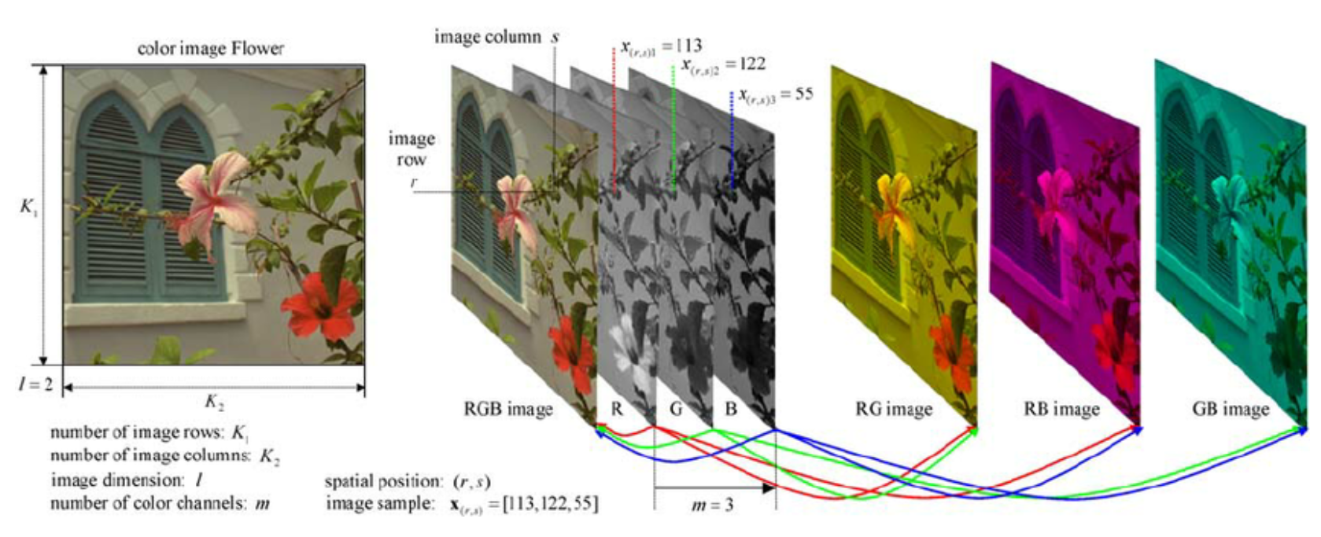
Introduction-Image Representation
A grayscale image is represented as a 2-dimensional array where:
P(x, y) is a pixel position in 2D. The value of P(x, y) ranges from 0 to 255. 0 being black and 255 being white.
LUKAC, RASTISLAV & Plataniotis, Konstantinos. (2006). Single-Sensor Camera Image Processing. . 10.1201/9781420009781.ch16.

Slide 5
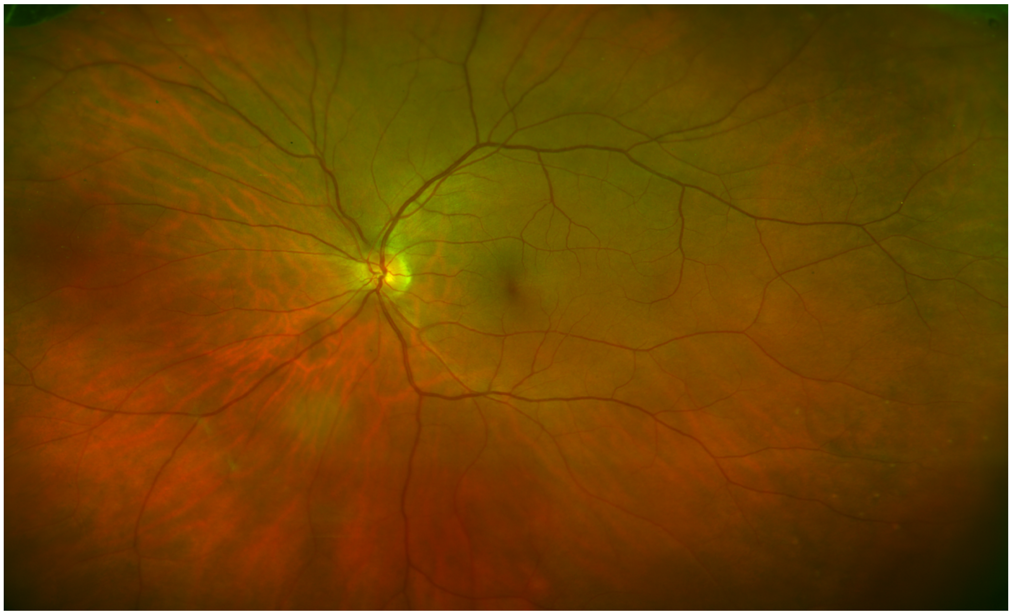
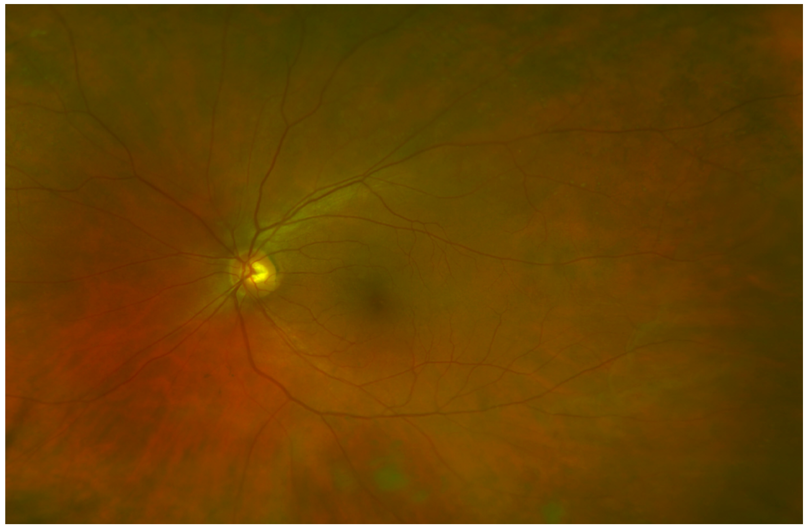
Motivation
Fundus Image(Ophthalmoscopy, also called Fundoscopy)
Changes in some vascular attributes in the eye are indicators of various health related problems.
Age Related Macular Degeneration Wet/Dry
Optic atrophy
Optic neuritis
Papilledema
Ischemic optic neuropathy
Glaucoma and Diabetic retinopathy

Slide 6
Motivation-Vessel attributes
AV(Artery to Vein) ratio
Branching angles
Bifurcation
Fractal dimension
Tortuosity
Vascular length-to-diameter ratio
Wall-to-lumen length
We are trying to correctly extract above attributes given a fundus image
So, first need to correctly extract the vessel structure.

Slide 7
Methodology
Wide Image(Green Channel)
Bilateral Filter
Gabor Filter
Generate Lattice Graph
Run MST algorithm
Segmentation result
Neighbors of pixel P(400, 333)

Slide 8
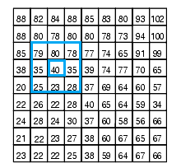
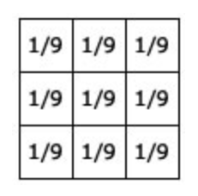
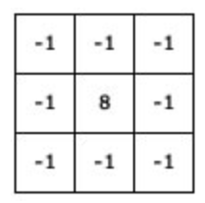
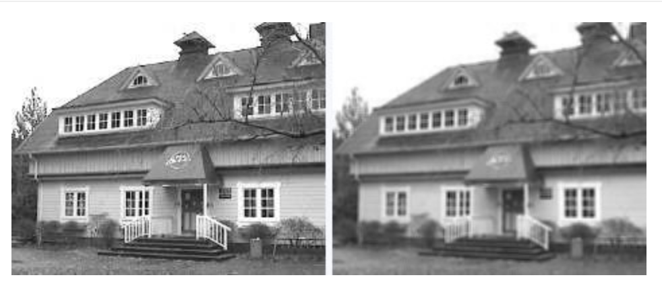
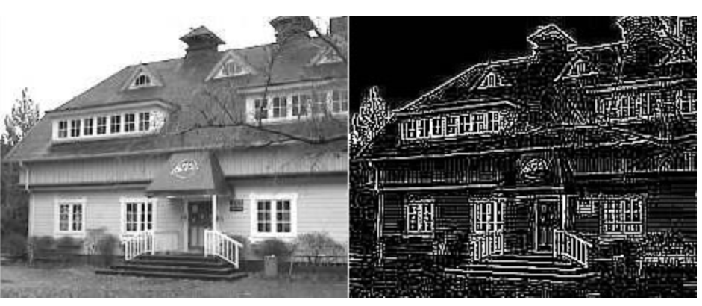
Methodology-Image Filtering/Convolution
Adding each element of the image to its local neighbors, weighted by the kernel.
Example of 3 * 3 kernel than averages (Mean blur)
Can be of different sizes.
Images: http://aishack.in/tutorials/image-convolution-examples/Image convolution examples, ”Image convolution examples ”

Slide 9
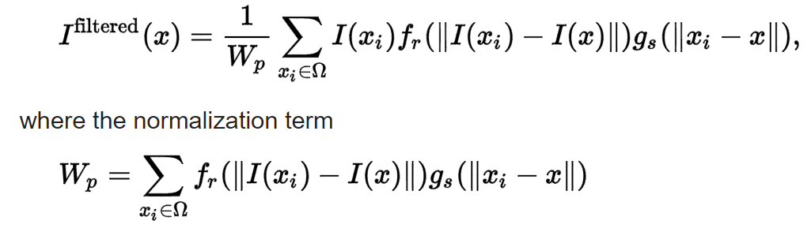
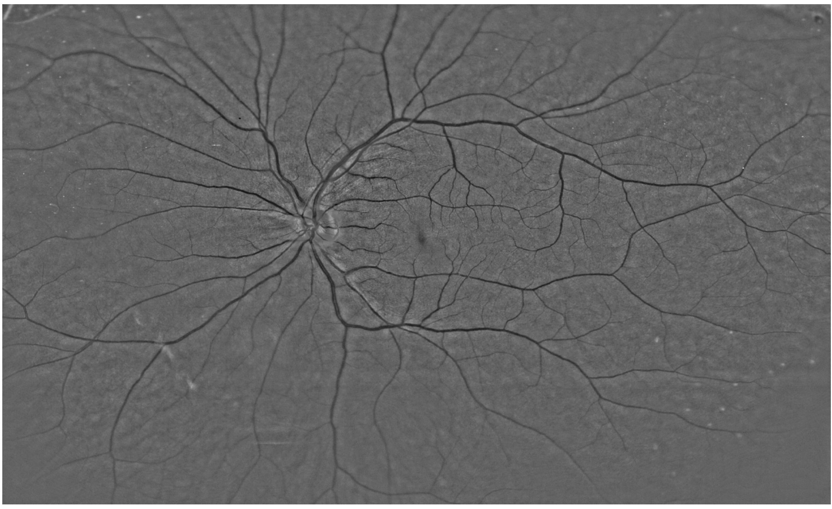
Methodology-Bilateral Filter
Blurring effect but preserves edges unlike Gaussian filter.
Where,
Ifiltered is the filtered image.
I is the original image.
x are the coordinates of the current pixel to be filtered.
Ω is the window centered in x.
fr is the range kernel for smoothing differences in intensities
Gs is the spatial kernel for smoothing differences in coordinates.
I(x) is the intensity value at pixel x.
Mark S. Nixon and Alberto S. Aguado. Feature Extraction and Image Processing. Academic Press, 2008
E. Arias-Castro and D. L. Donoho, "Does median filtering truly preserve edges better than linear filtering?", Annals of Statistics, vol. 37

Slide 10
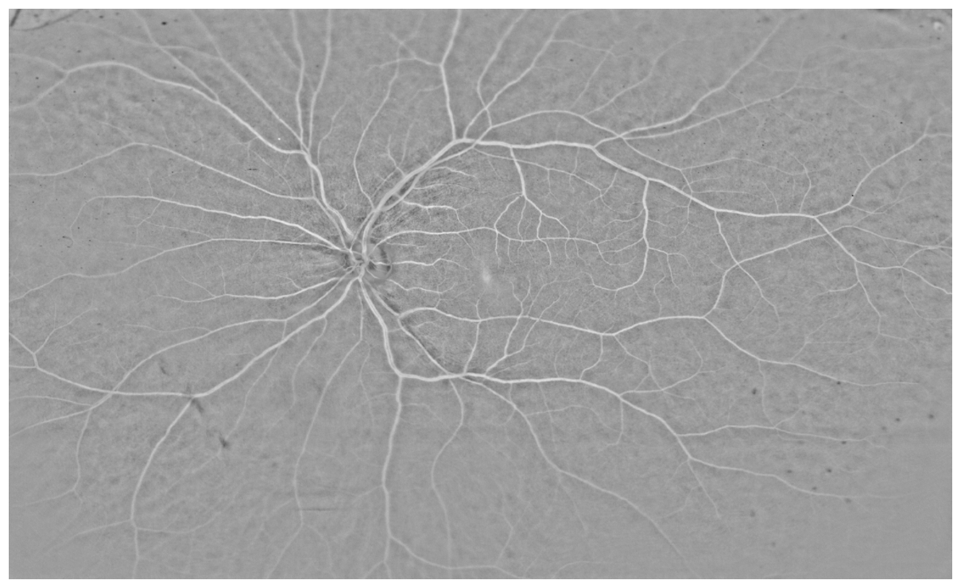
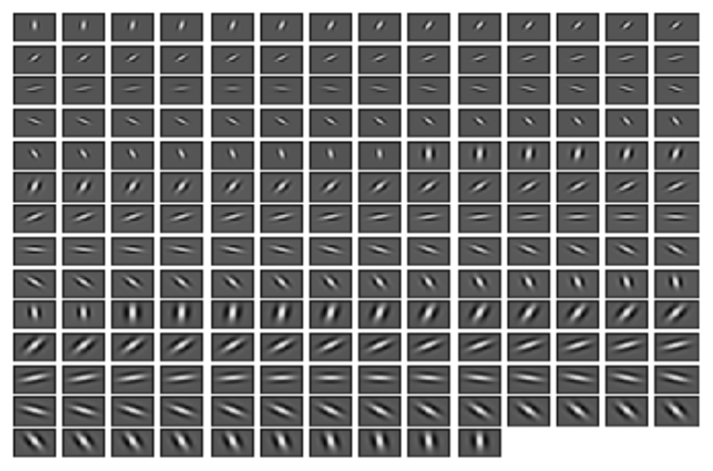
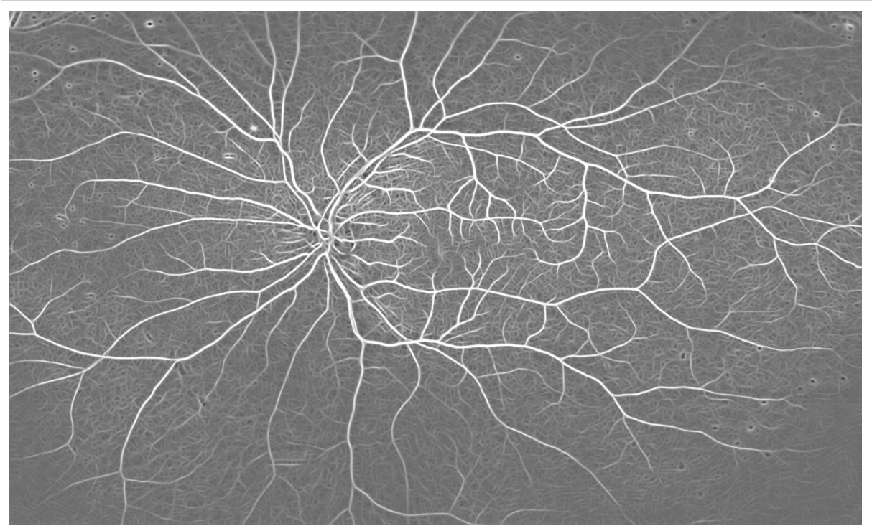
Methodology-Gabor filter
Gabor filtering is a convolution technique in which the response is maximum to predefined texture structure and its orientation.
Three kernels of size 31 * 31 with 64 orientation each.
Texture structure is given by Gabor kernel bank.
Daugman, J.G. (1980), "Two-dimensional spectral analysis of cortical receptive field profiles", Vision Res., 20 (10): 847–56, doi:10.1016/0042-6989(80)90065-6, PMID 7467139
Hans G. Feichtinger, Thomas Strohmer: "Gabor Analysis and Algorithms", Birkhäuser, 1998; ISBN 0-8176-3959-4

Slide 11
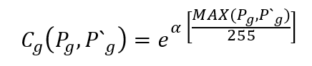
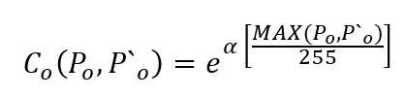
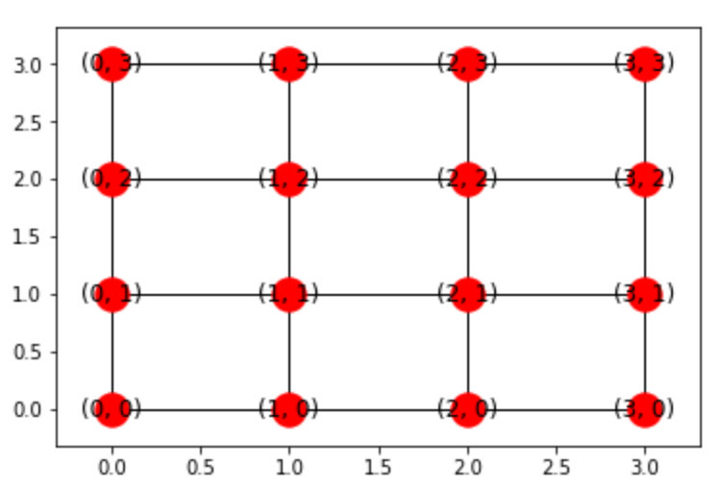
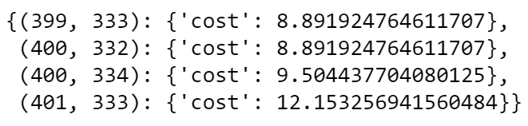
Methodology-Lattice graph and cost assignment
Each pixel is connected to 4 of its neighbors.
Cost of traversal from one pixel to one of its neighbor
Where,
o = Green channel of original image
g = Inverted response of Result image from Gabor filter
P = Intensity value of pixel (x, y)
p` = Intensity value of any neighbor of pixel (x, y)
α = Constant value. (We use 5)
Neighbors of pixel P(400, 333)

Slide 12
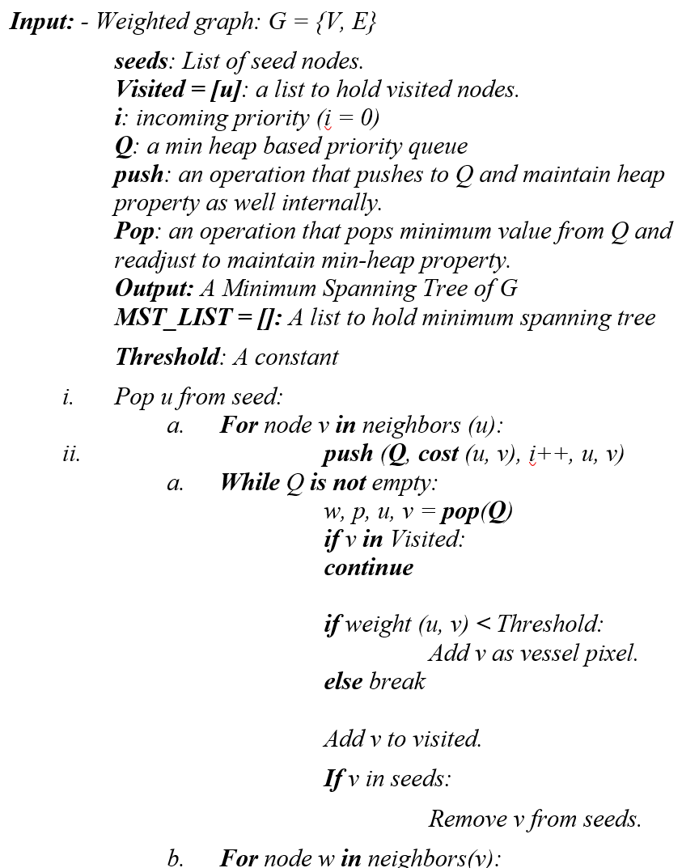
Methodology-MST algorithm
Use list of seed pixels to make sure we capture isolated vessles.
Runs: ο (|E| log |V|)
Aric Hagberg, Dan Schult, Pieter Swart, Loïc Séguin-C, 2015, https://networkx.github.io/documentation/networkx-1.9/_modules/networkx/algorithms/mst.html

Slide 13
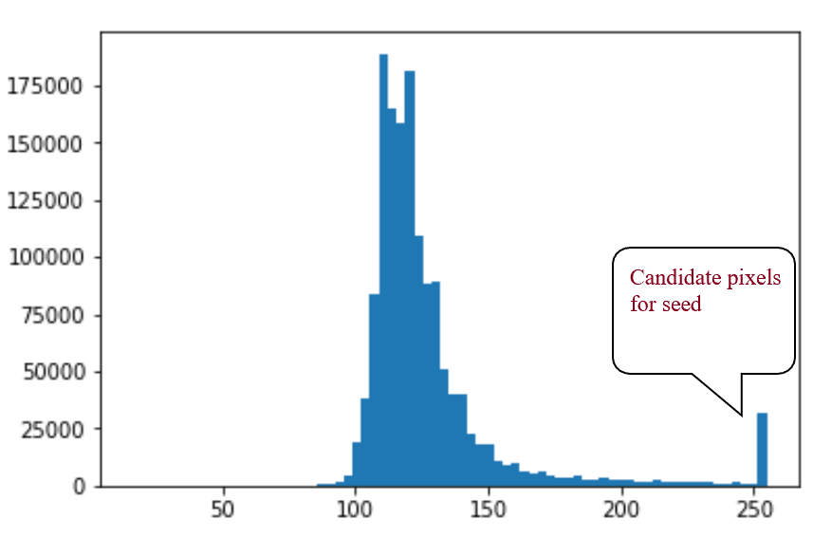
Methodology-Seed Selection
We have used histogram based approach for seed selection.

Slide 14
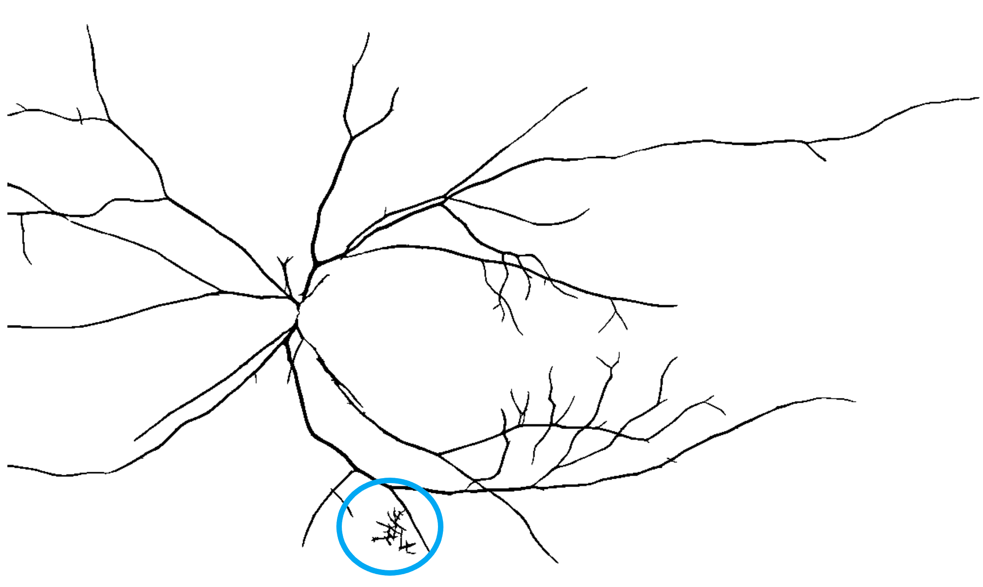
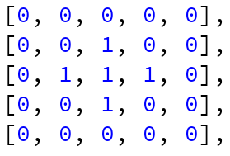
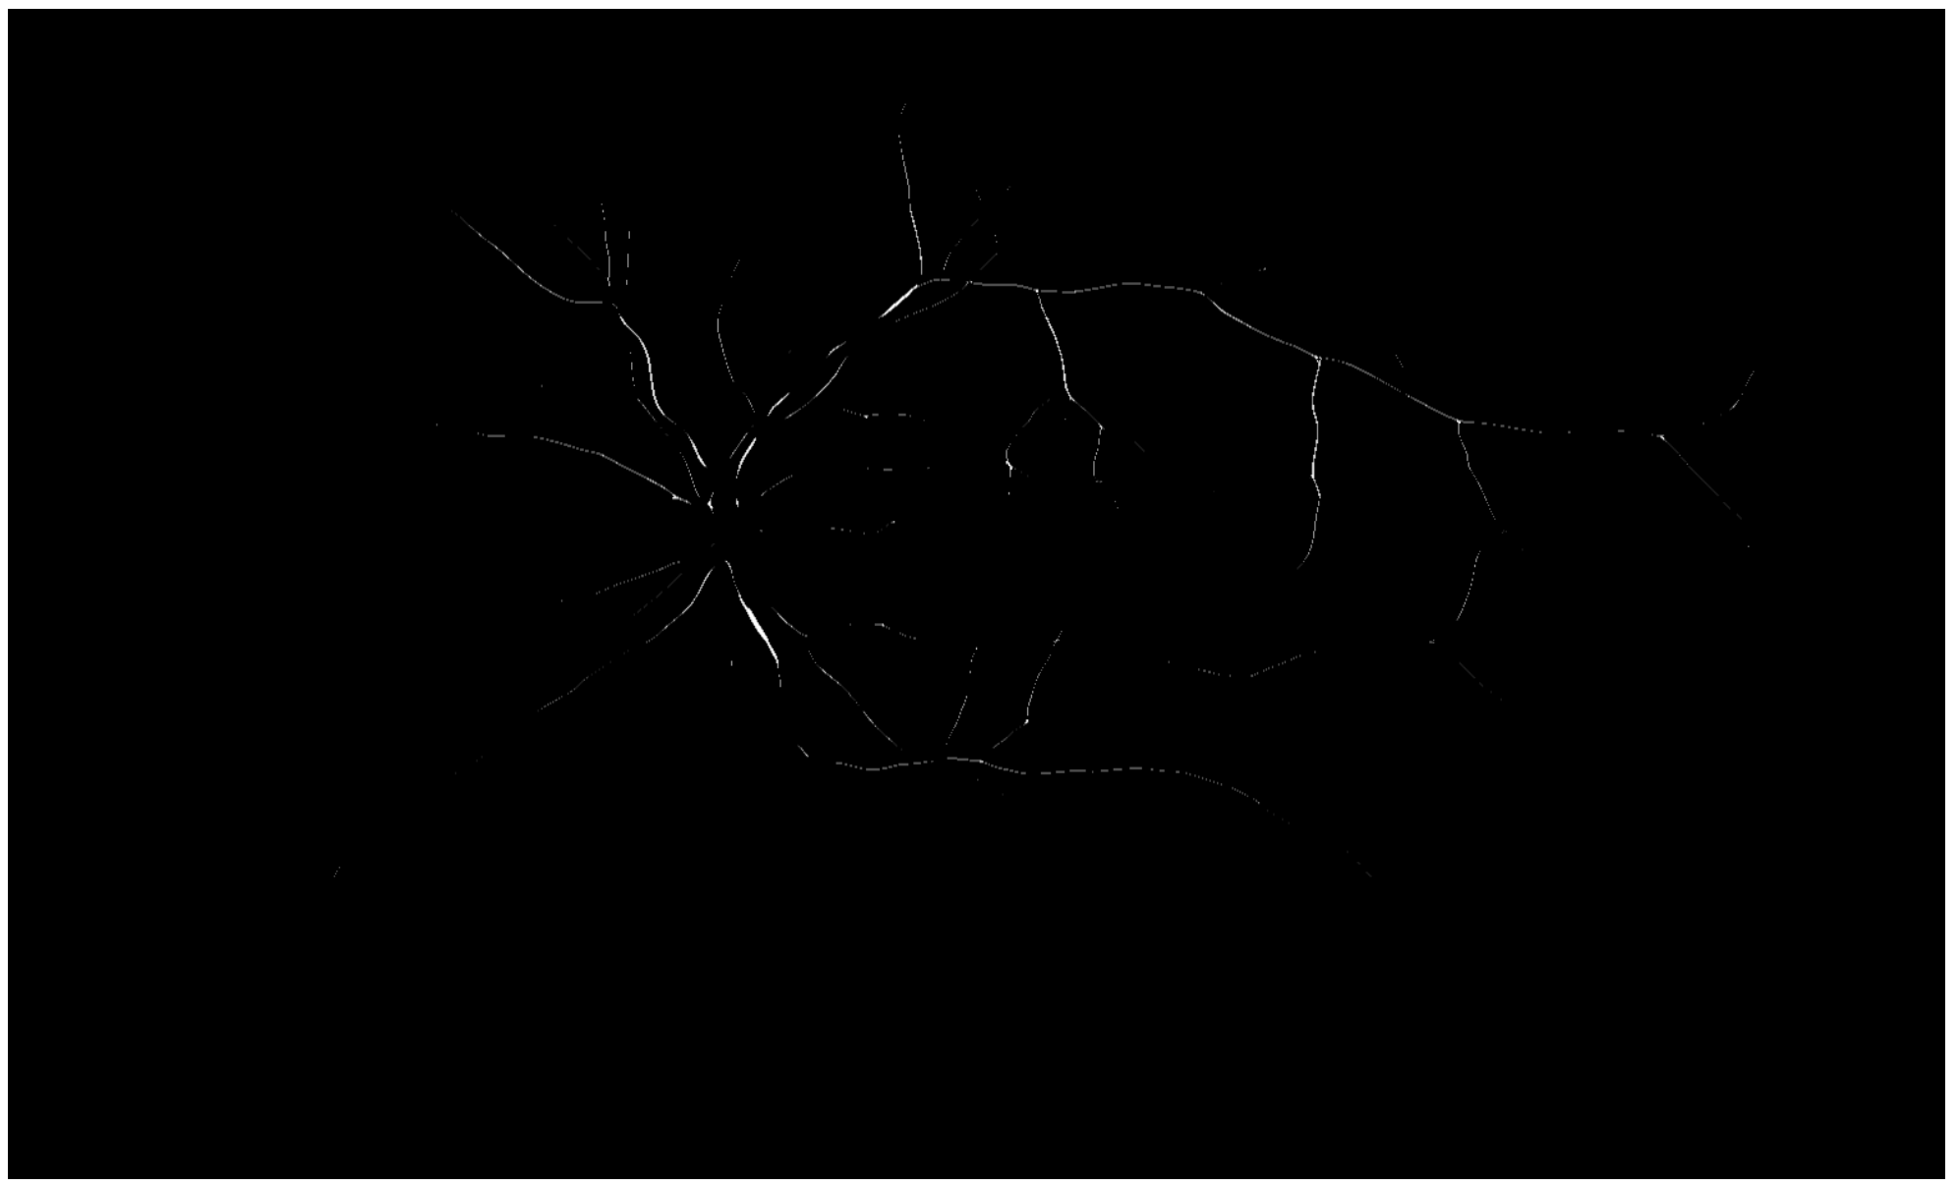
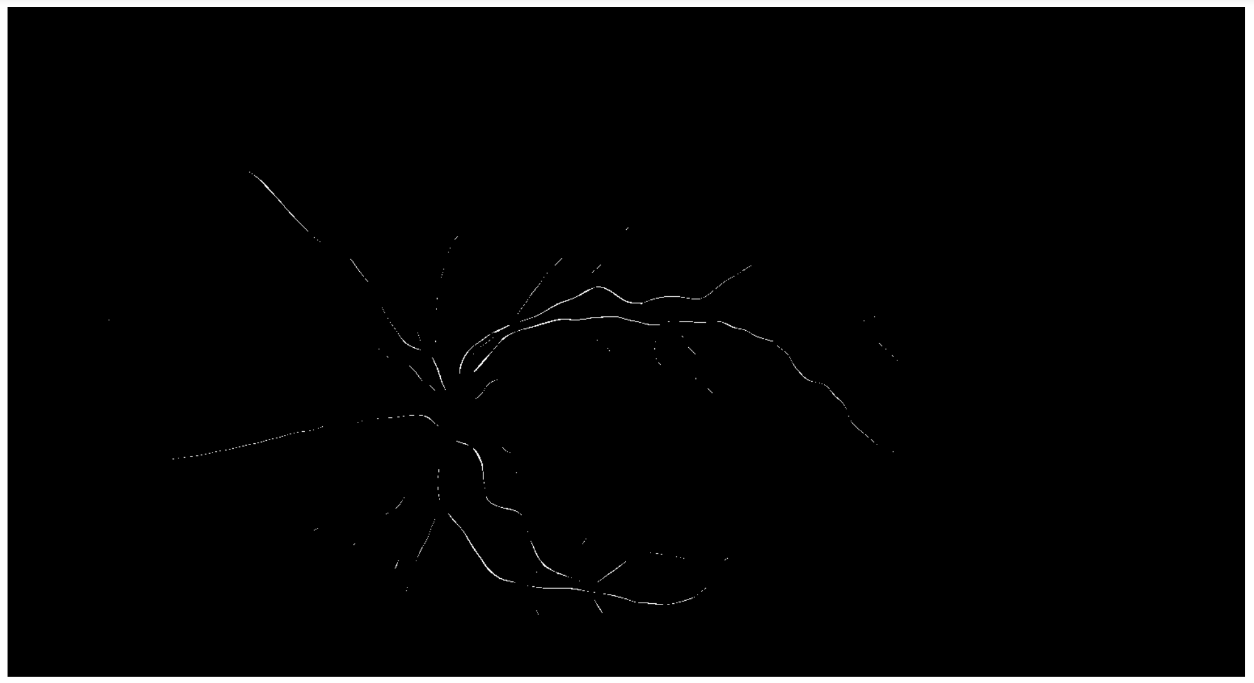
Methodology-Seed Selection
A problem with just thresholding the pixels with highest intensity.
Some seed can be of non-vessel region and can lead to unusable segmentation.
Solution is to remove isolated pixels.
Convolve the seed with a new kernel
Wrong seed selection. Algorithm starts from non vessel region

Slide 15
Experiments
We have tested on 30 data sets. (No ground truth values)
Finally, We will train the system for 20 images and adjust the following parameters that yields the best F1 score.
Bilateral filter parameters
Gabor filter parameters
α in lattice graph cost assignment
Start from low value like 1 and run until higher value like 20. Simultaneously plot precision and recall graph and use the value that yields best precision and recall.
Threshold in Minimum Spanning Tree
Start from low value like 1 and run until higher value like 10. Simultaneously plot precision and recall graph and use the value that yields best precision and recall.
A rough estimate was achieved with the average cost among the neighbors of the seeds.
Then we test with the remaining 10 images with the same setting.

Slide 16
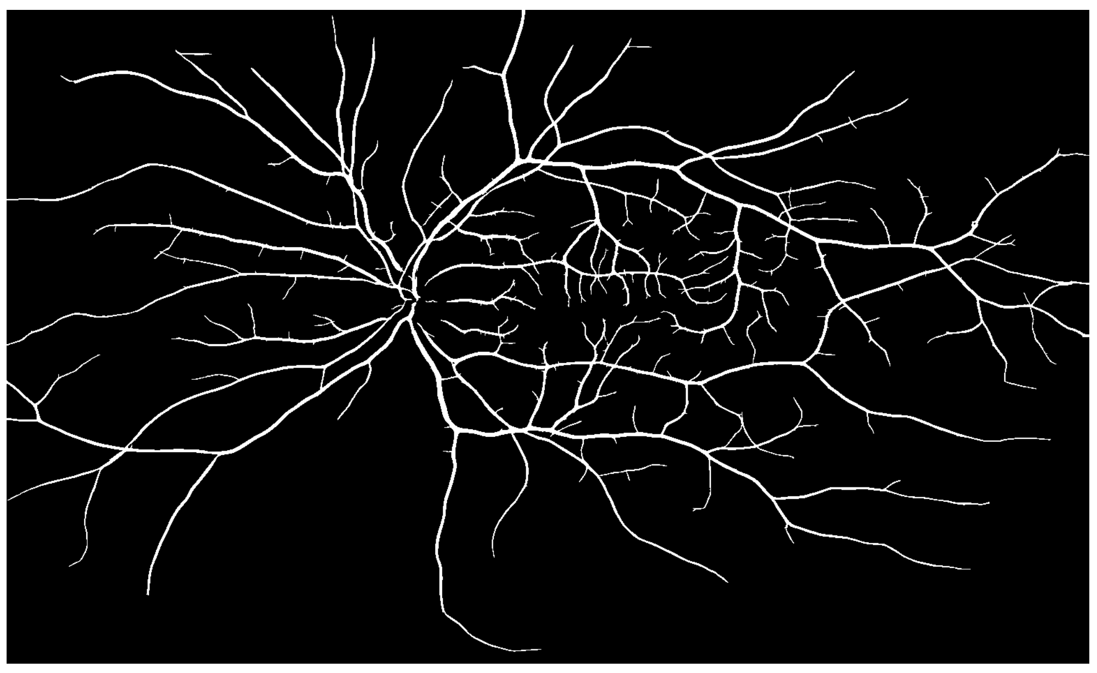
Experiments-Results

Slide 17
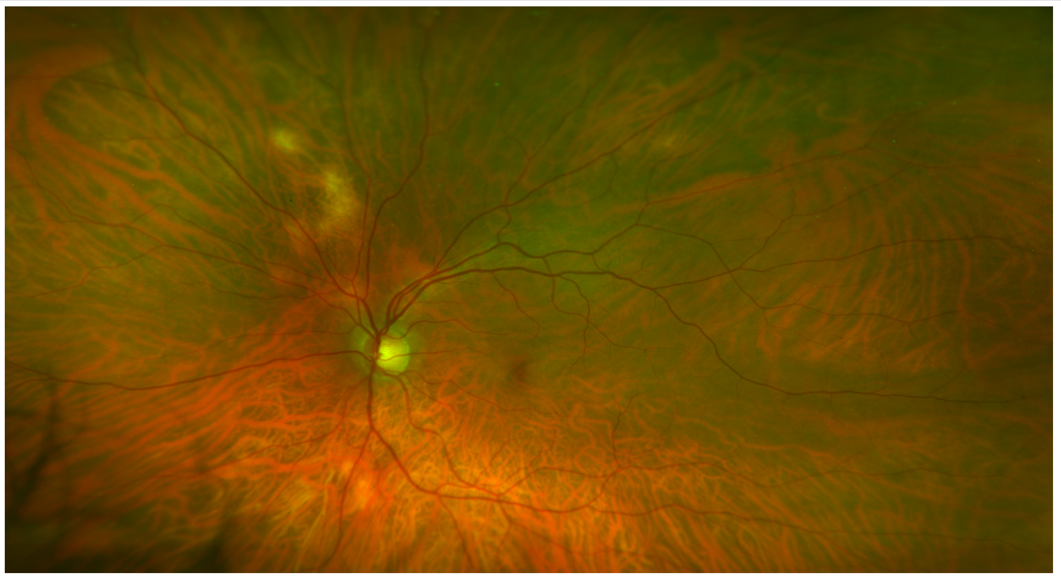
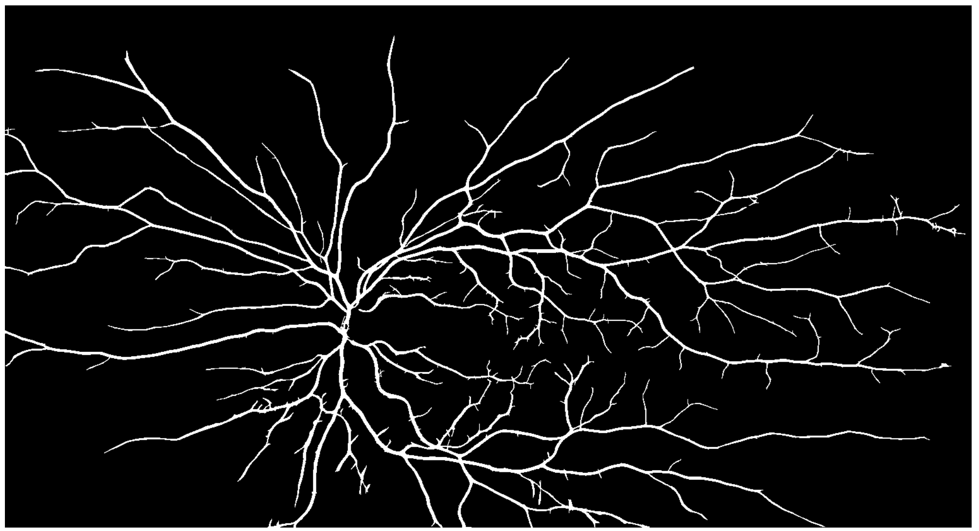
Experiments-Results

Slide 18
Thank you!

